Slide 1
Model Explainability
20.06.22 by Sengul Karaderili

Slide 2
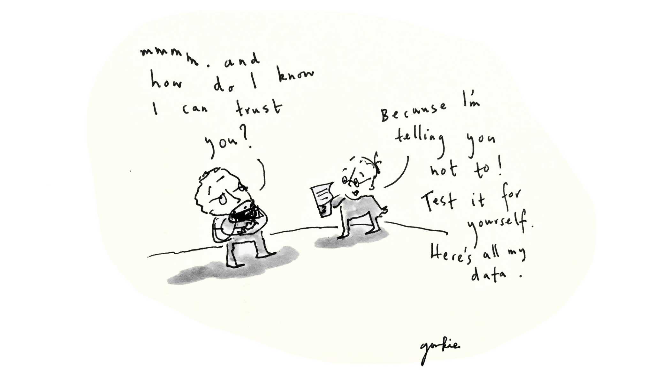
🚀 Agenda
What is explainable AI?
Why are these insights valuable?
Permutation Importance
Partial Dependence Plot
SHAP Library
Code Lab 2: AI Explainability
WIT Tool
Visualize TS
Code Lab 2: Visualize TS with Prophet
Sources & the end of the party

Slide 3
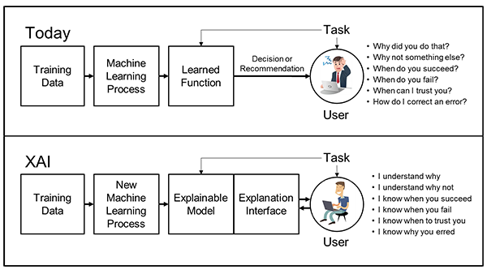
What is explainable AI?

Slide 4
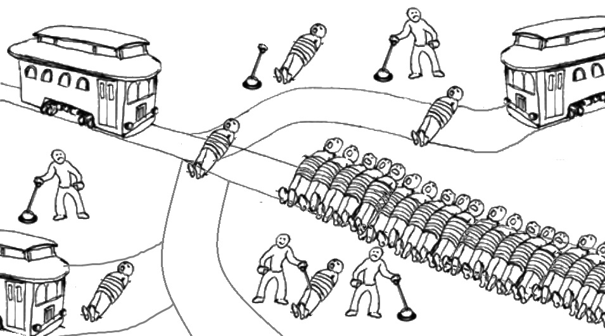
Why Are These Insights Valuable?
Debugging
Informing feature engineering
Directing future data collection
Informing human decision-making
Building Trust

Slide 5
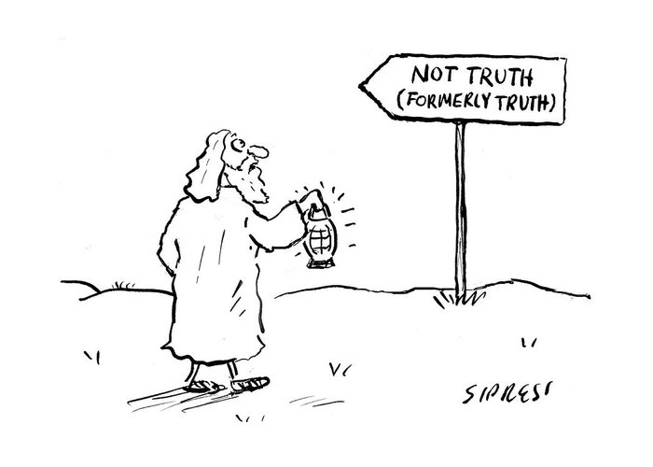
Two types of interpretation:
Global Interpretation: inspect model parameters and try to figure out how the model works globally.
Local Interpretation: inspect an individual prediction of a model, try to figure out why the model makes the decision it makes.

Slide 6
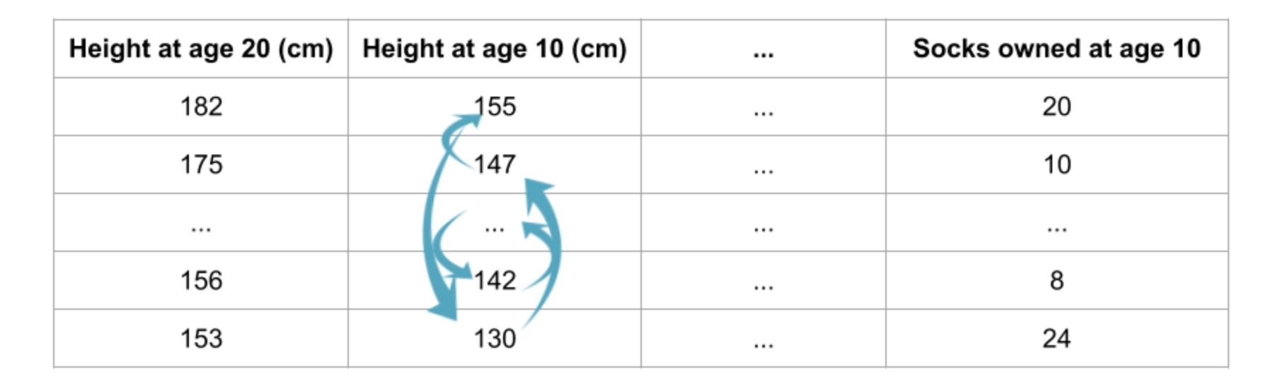
Permutation Importance
Mean Decrease Accuracy (MDA)
Get a trained model.
Shuffle the values in a single column and make predictions
Repeat step 2.

Slide 7
Column Drop Importance
More accurate but expensive. Because every time;
1- We temporarily remove 1 column and re-fit model.
2- We compute val set performance and compare.

Slide 8
Partial Dependence Plot
While feature importance shows what variables MOST affect predictions, partial dependence plots show HOW a feature affects predictions.

Slide 9
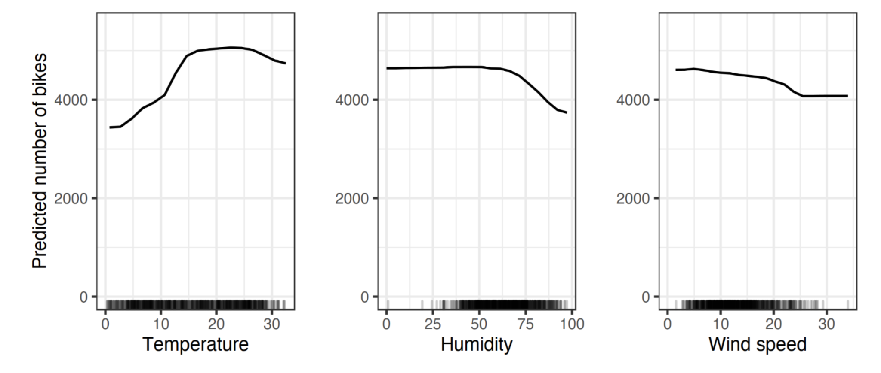
Example: Fitted a random forest to predict the number of bicycles and use the partial dependence plot to visualize.
The influence of the weather features on the predicted bike counts is visualized in the following figure.
Ref: https://christophm.github.io/interpretable-ml-book/pdp.html

Slide 10
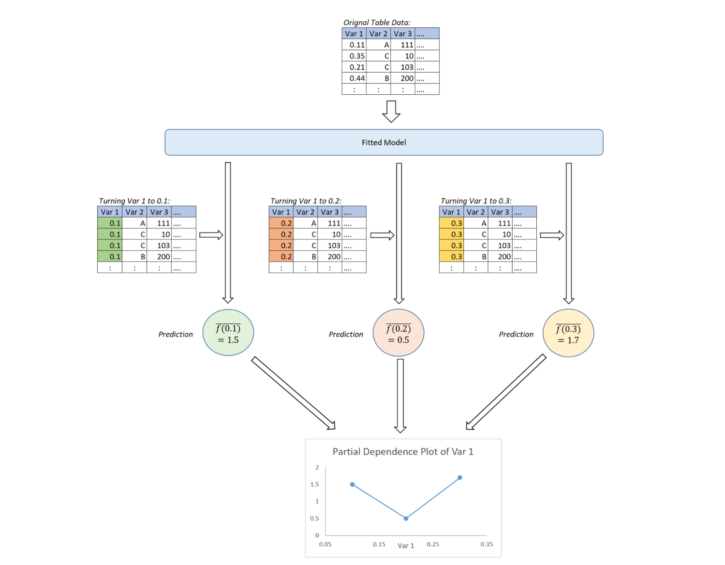
PD Plot Logic

Slide 11
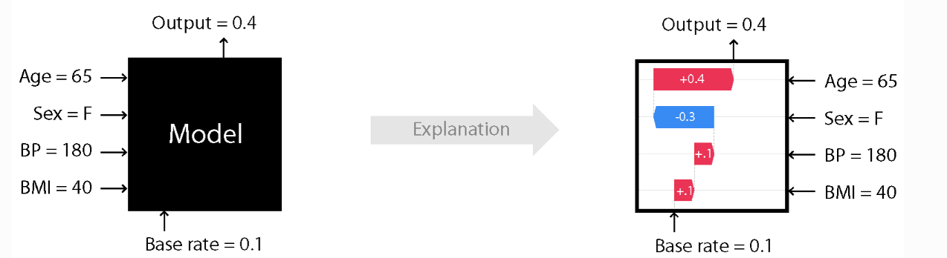
SHAP
SHAP (SHapley Additive exPlanations) is a game theoretic approach to explain the output of any machine learning model.
SHAP values interpret the impact of having a certain value for a given feature in comparison to the prediction we'd make if that feature took some baseline value.

Slide 12
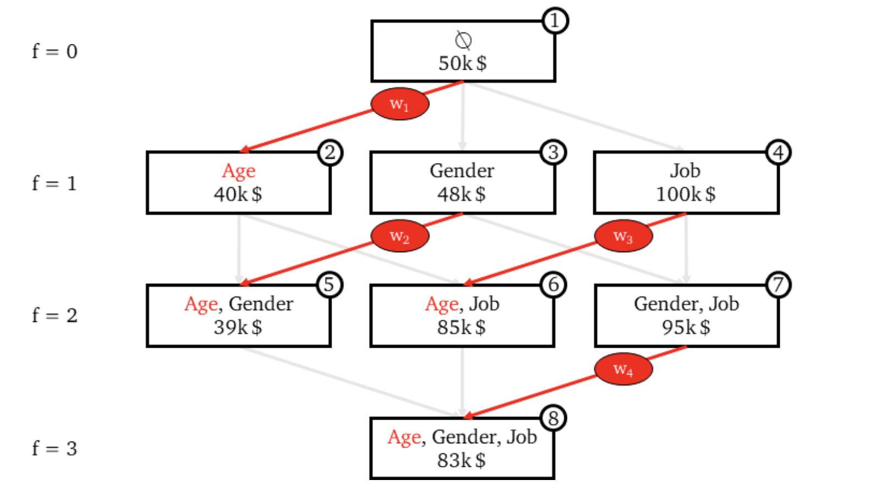
How SHAP works?

Slide 13
🔮 Code Lab:
AI Explainability Session
Colab Code
Ref.: Kaggle Course

Slide 14
What-If Tool
WIT provides an easy-to-use interface for expanding understanding of black-box classification and regression ML models.
Jupyter
Tensorboard
Colab
Examples:
Age Regression
Smile Detector

Slide 15
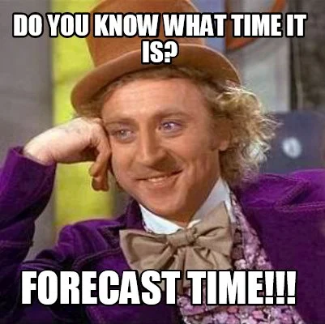
Visualize TF
Prophet is a procedure for forecasting time series data based on an additive model where non-linear trends are fit with yearly, weekly, and daily seasonality, plus holiday effects. It works best with time series that have strong seasonal effects and several seasons of historical data. Prophet is robust to missing data and shifts in the trend, and typically handles outliers well.

Slide 16
Components:
Trend models non periodic changes in the time series data.
Seasonality is caused due to the periodic changes like daily, weekly, or yearly seasonality.
Holiday effect which occur on irregular schedules over a day or a period of days.
Error terms is what is not explained by the model.

Slide 17
Advantages
1. Accurate and fast
2. Fully automatic
3. Tunable forecasts
4. Available in R or Python
5. Handles seasonal variations well
6. Robust to outliers
7. Robust to missing data

Slide 18
🔮 Code Lab 2:
Visualize TS with Prophet
Colab Code
Prophet Doc

Slide 19
What If Tool
Google’s AI research team has designed a What-If Tool which is part of their open-source Tensorboard web application. The tool lets users analyze their machine learning models without the need of writing code. The UI is exemplary and offers a rich interactive interface for exploring different model results.

Slide 20
Other Sources
Interpretable ML: https://christophm.github.io/interpretable-ml-book/pdp.html
Kaggle ML Explainability: https://www.kaggle.com/learn/machine-learning-explainability
SHAP Blog: https://towardsdatascience.com/shap-explained-the-way-i-wish-someone-explained-it-to-me-ab81cc69ef30
Podcast Recommendation: https://open.spotify.com/episode/180CUHf9VrIgCk4uaqeiKi?si=2d7ade0122154942

Slide 21
Thanks for listening 🙏

